Slide 1
Problem Statement:
PS014 : IOT Based Weather Forecasting
JD’s Team :
Jemin Dadhania (IT)
Harsh Patel (Computer)
Jash Shah (Computer)
Hetvi Sakaria (Aero)
SVIT VASAD

Slide 2
Originality and innovation of our problem statement.
Weather forecasting is a significant function in meteorology and has been one of the most systematically challenging troubles around the world.This scheme deals with the structure of a weather display method using small cost components so that any electronics hobbyist can construct it. As a replacement for using sensors to collect the weather data, the development gets the information from weather stations placed around the world through a global weather data supplier. Severe weather phenomena challenged difficult weather forecast approach with the partial explanation. Weather events have numerous parameters that are not possible to detail and compute. Growing on communication methods enables weather predicts specialist systems to combine and share possessions and thus hybrid systems have emerged. Still, though these improvements on climate predict, these expert systems can’t be entirely reliable while weather forecast is central problem.

Slide 3
How our problem statement suffices our aim of multidisciplinary Collaboration
Our problem statement which consists of making a weather forecasting system has a circuit other than the IOT application which comes in the field of computers also requires the knowledge of electrical components and circuits

Slide 4
How's our project feasible and cost effective.
First the circuit of control unit system have been made that ESP8266 microcontroller control all weather
parameters sensor, that are DHT11 (Temperature and Humidity) sensor, Rain sensor, and LDR sensor. Then it powered by USB cable also to upload the sketch of coding in ESP8266. The sensor data can be display on serial monitor in Arduino IDE software. ESP8266,will connect with the Wi-Fi hotspot that have applied to this system so that the web server can be create to display all the sensor data.
Data that received by weather station will be displaying on LCD as the communication of both sensor station and weather station by using Wi-Fi hotspot. The communication is successfully established.
The web server contains html that can display the sensor data by simple coding and connection where the IP address of the ESP8266 are needed to complete this action. After that it will read all the sensor value and then send to the cloud data where Blynk has been uses for this. ThingSpeak will stored the sensor value and display that data to the channel create there. The user can check the weather parameter via ThingSpeak websites. The data has collected from the reading of ESP8266 for all sensor and send that data to the Blynk as the results of this project objective. The analysis of the data has been made and there are table comparing the data with the help of the graph on this Blynk App and Web Console.

Slide 5
Components used:
Rain Sensor
Temperature And Humidity Sensor
Node MCU – ESP8266
Barometric Sensor
5V Power supply regulator
LDR Module
16×2 display with type I2C adapter module
Breadboard
Jumper Cables

Slide 6
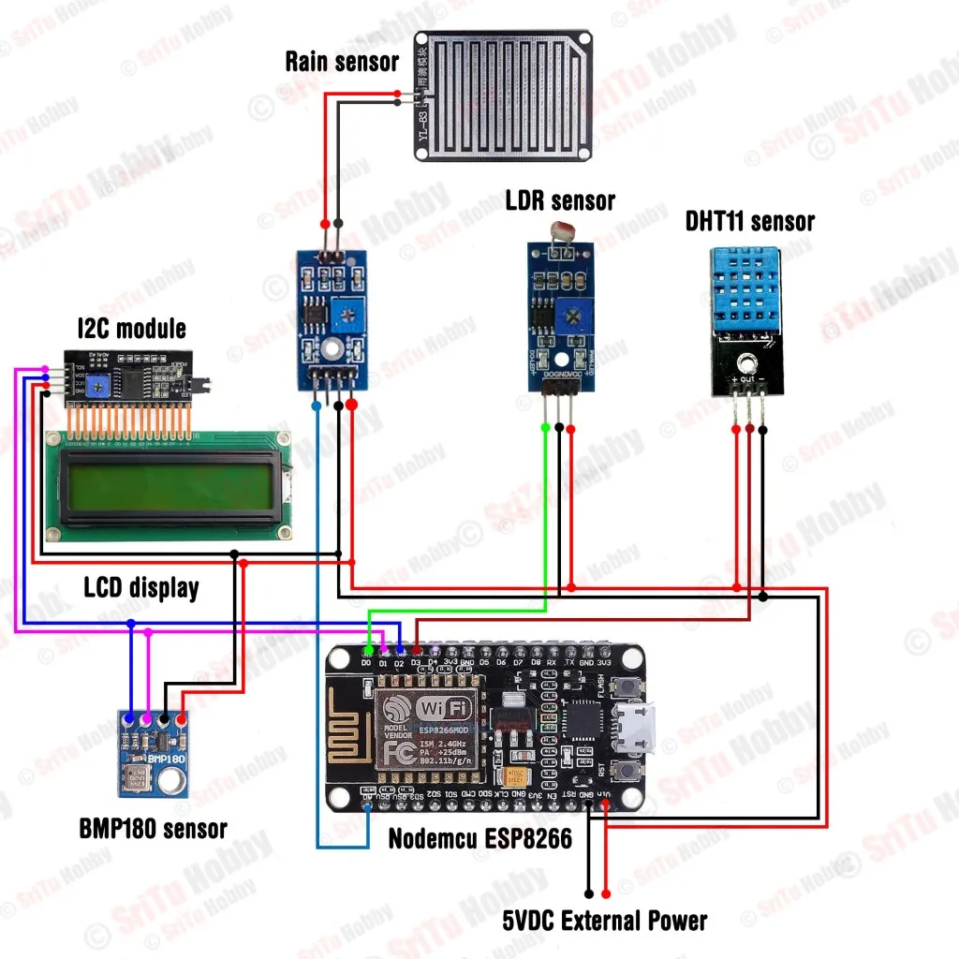
Circuit Diagram:

Slide 7
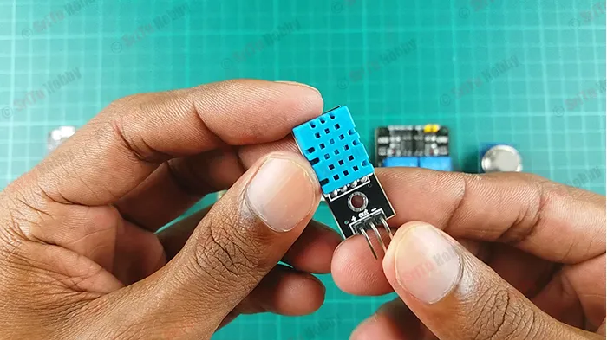
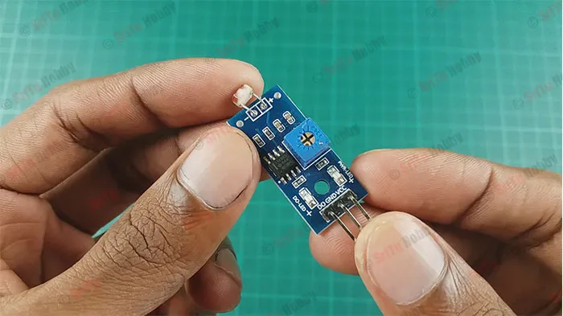
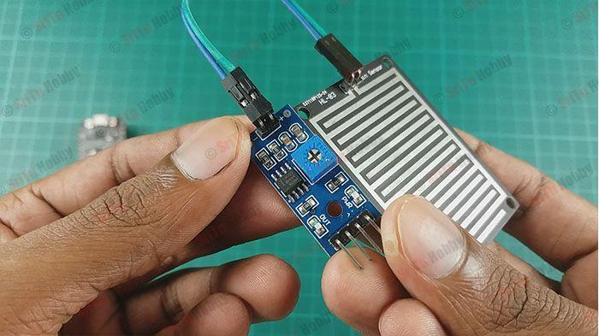
SENSORS:
DHT-11 sensor:
Through this sensor, we can get temperature and humidity values.
LDR sensor:
We can measure the Light value using this sensor. For that, I used an LDR sensor module. But, you can use a single LDR sensor.
Rain sensor
Using this sensor, we can get the rainfall values. Also, you can get that value either analog or digitally through this sensor.

Slide 8
What is IOT based weather forecasting system ?
The system proposed is an advanced solution for weather monitoring that uses IoT to make its real time data easily accessible over a very wide range. The system deals with monitoring weather and climate changes like temperature, humidity, moisture, light intensity, UV radiation ; using multiple sensors. These sensors send the data to the web page and the sensor data is plotted as graphical statistics.
The data uploaded to the web page can easily be accessible from anywhere in the world. The data gathered in these web pages can also be used for future references. The project even consists of an app that sends notifications as an effective alert system to warn people about sudden and drastic weather changes. For predicting more complex weather forecast that can’t be done by sensors alone we use an API that analyses the data collected by the sensors and predicts an accurate outcome.
This API can be used to access the data anywhere and at any time with relative ease and can also be used to store data for future use.

Slide 9
Areas Benefiting from Weather Forecasting System Using IoT
An accurate weather report is forecasted directly or indirectly to influence other sectors of the economy to raise the need for a system that facilitates higher accuracy of real-time monitoring and future weather prediction.
But what exactly are the different sectors that benefit from the IoT weather station? Well, let’s have a look at them!
Agriculture:
With the current global trends for agriculture and the depletion of natural resources, the demand has increased. Preparation of soil, sowing, irrigation, and harvesting of crops are directly dependent on weather conditions. The IoT technology is fueling the transformation, helping farmers vulnerable to weather hazards to use the IoT intelligence for improving their crop fertility and cost. The integration of real-time data into supply chain plans is assisting in the transportation of perishable commodities across the country, resulting in increased productivity and efficiency.

Slide 10
Future scope of IoT based weather monitoring system
The technology of IoT has expanded in all sectors, and with the future scope and advantages of IoT-based weather monitoring systems, numerous industries can leverage them.
The IoT weather reporting system has an application for farmers where they can ensure higher productivity of crops and lower the risk of weather hazards via the IoT weather.
The IoT-based weather station proves helpful for monitoring the weather in areas like places with volcanoes or rain forests. This is especially important with drastic changes in the weather conditions we are experiencing.
The IoT weather monitoring system using IoT supporting controllers is fully automated and efficient. It does not require any manual labor or attention.
Hence, with such advances on the Internet of Things (IoT), organizations are focusing on understanding the impact of weather on their operations and finding cutting-edge analytics on how to control the impact of their business

Slide 11


Slide 12
Reference links:
https://srituhobby.com/how-to-make-a-weather-monitoring-system-using-the-nodemcu-esp8266-board-and-the-new-blynk-app/
https://youtu.be/pOB8-pi796I
https://electronics-project-hub.com/iot-based-weather-monitoring-system-using-arduino/
https://www.airtel.in/blog/business/iot-use-cases-in-real-time-weather-monitoring-system/

